Slide 1
Being agile in a hybrid contact centre environment
Alan Linter
Innovation & Data Science Director
Capita Customer Management
Gill Burgess
Operational Delivery Director
Capita Customer Management

Slide 2
Our Vision: New Ways of Working at Capita
At Capita, work is about the outcomes we create, not the place we go.
Our colleagues are empowered to work in the most flexible and dynamic way their roles will allow, establishing a renewed focus on productivity, innovation and engagement.

Slide 3
Why do we need to develop our ways of working?
The Pandemic forced us to move the majority of our workforce to work from home, whilst retaining a physical office presence.
Covid-19 has enabled us and our clients to see the world differently and is affording the opportunity to accelerate towards digital, whilst reducing our physical infrastructure.
Interim commercial terms were rapidly put in place to cover homeworking temporarily. Now need to be priced and CTQ’s addressed to make sustainable.
Rationale for developing our hybrid model
We have rapidly deployed homeworking solutions to c.21,000 colleagues. In the process we moved some clients across to our new Digital Ecosystem, which is already changing our relationship with them.
The pandemic has triggered rapidly changing customer behaviour and propensity to adopt digital.
In the face of adversity, the different parts of our business have worked together to solve for our customers, in a way that demonstrates what we can achieve as one.
We now need to work out what investments we have to make to pivot to the new way of working
Notes:
Shalabh – while we might have had intentions of homeworking previously, the pandemic accelerated our progress.
As we reacted so fast, we need to remedy for the long term
By solutioning properly, up side for us and clients
Race against the competition to do this at a good quality, as well as at speed – grasp the opportunity

Slide 4
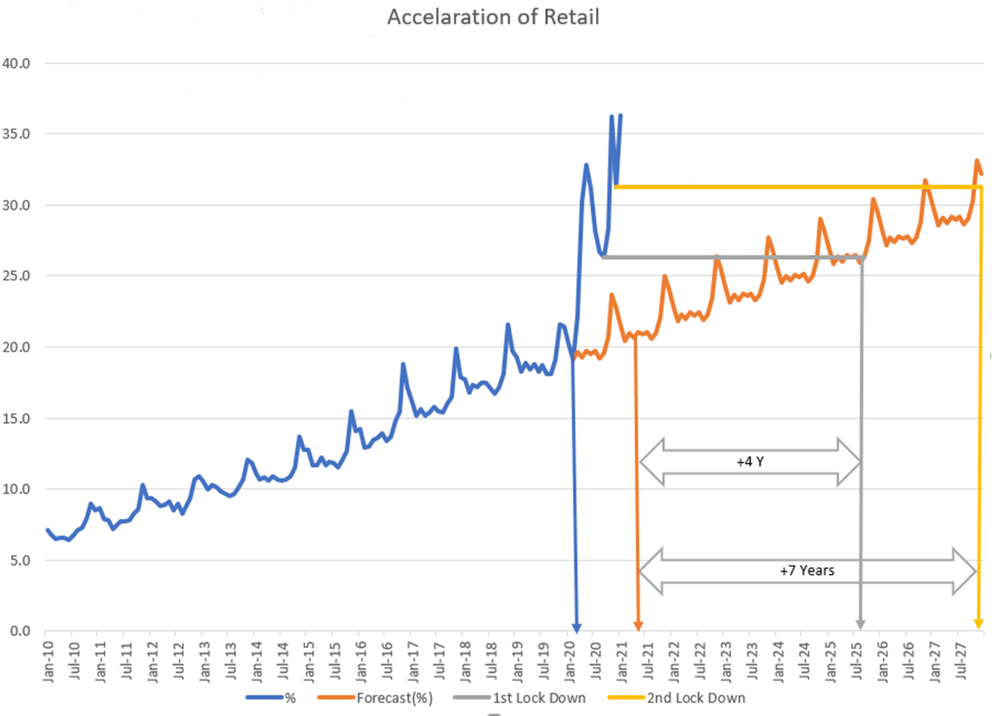



Outcomes
  Superior resolution rates
  Higher satisfaction, Lower cost to serve
  Greater customer brand advocacy, retention & lifetime value
Services
Automated
transactions
Automated conversation
High value conversation
Insights-as-a-service
Simple and digital self service for routine and transactional issues
Automated interventions to speed up and reduce cost of conversation elements
Agent-led expertise (voice) for complex / emotional issues & sales-through-service
Consulting and analytical insights for process and episode redesign
Trends
Increased uncertainty
Increased emotive “Life Moments”
Increased emotion and complexity
Forced rapid adoption which saw trends accelerated by 5-7 years, automating greater volumes of simpler transactions
Overall harder mix of contacts for agents to answer as simpler calls removed

Slide 5
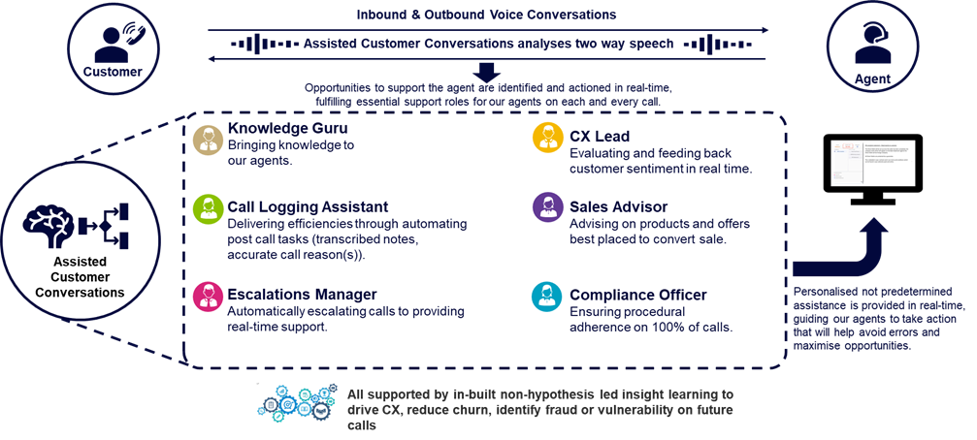

  Supporting Agents in A Hybrid Work Environment In “Emotional Times”
Sentiment
Emotion

Slide 6
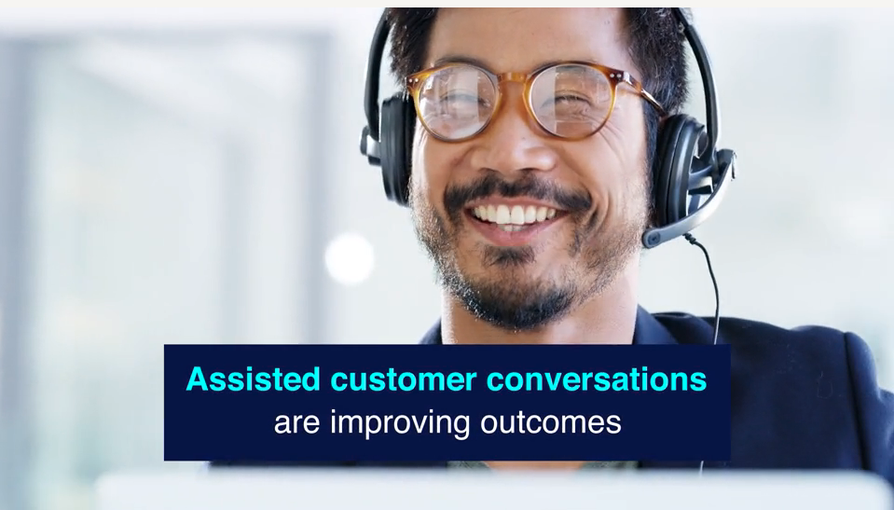
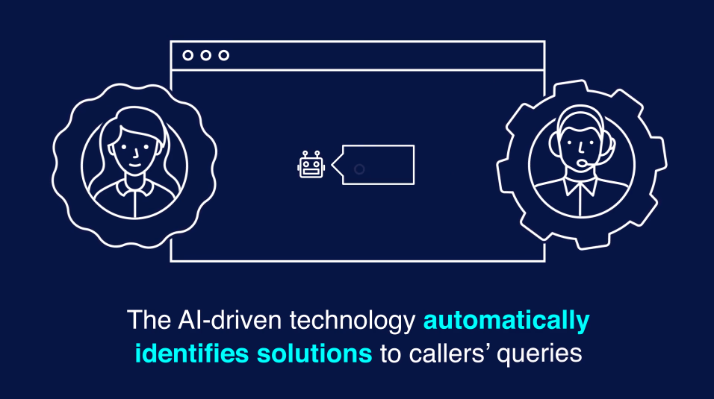
Equipping Agents EQ deliver empathetic conversations
Examples https://capita.wistia.com/medias/ol5hjscgyt
Could we use some of the examples in the new ACC rather than the old Augmented commerce in the next 3 slides?

Slide 7






The journey from tech to human
Save your customer’s time
with automation
Right Tech for the Right Experience
Creating immersive experiences
1
2
3
4
5
6
Provide a multi-channel
experience
Leverage the right analytical tools
Chatbots on call
Notes:
Provide A Multichannel Experience
Conversational AI, data intelligence and real-time analytics provides customers with a fluid and modern multichannel support experience
Save Your Customers’ Time With Automation
Automation can make a huge difference in saving customers’ time and still satisfying their needs, drastically improving brand loyalty
Chatbots on Call
Can answer the most common question first , with a human handling the more advanced ones, building sustainable success
Leverage The Right Analytics Tools
Deliver a unique CX to each individual by analysing their behaviours augmenting and analysing data for actionable insights and outstanding CX
‘Always On’ CX
Customers increasingly expect on-demand services. Always-on conversational interfaces can help customers troubleshoot issues, manage accounts and get answers 24/7
The Right Tech For The Right Situation
Tech serves as “intelligence augmentation” to help deliver a personalised customer experience: recognising the need for AI, chatbots and automation in certain situations but switching when customers want real human assistance
Creating immersive experiences
In an increasingly virtual world customers want to emulate a physical world through the means of a digital or simulated world by creating a surrounding sensory feeling

Slide 8

Customer satisfaction in real time - Powered by data

Slide 9
Q&A/Discussion with Leigh, Alan & Gill

Slide 10
www.capita.com

